Slide 1

Sunflower Seeds Ukraine
and the BB Jam project
August 2024
www.sunflowerseedsukraine.org

Slide 2


Sunflower Seeds Ukraine
Vision:
save lives and reduce suffering in Ukraine
Mission:
provide medical aid and protective gear to small groups of defenders
Fundraising, development in Colorado, USA
Logistics and outreach in Europe
Distribution center near Rivne, Ukraine
Direct contacts on the front lines
Registered organizations in USA and Ukraine
www.sunflowerseedsukraine.org

Slide 3

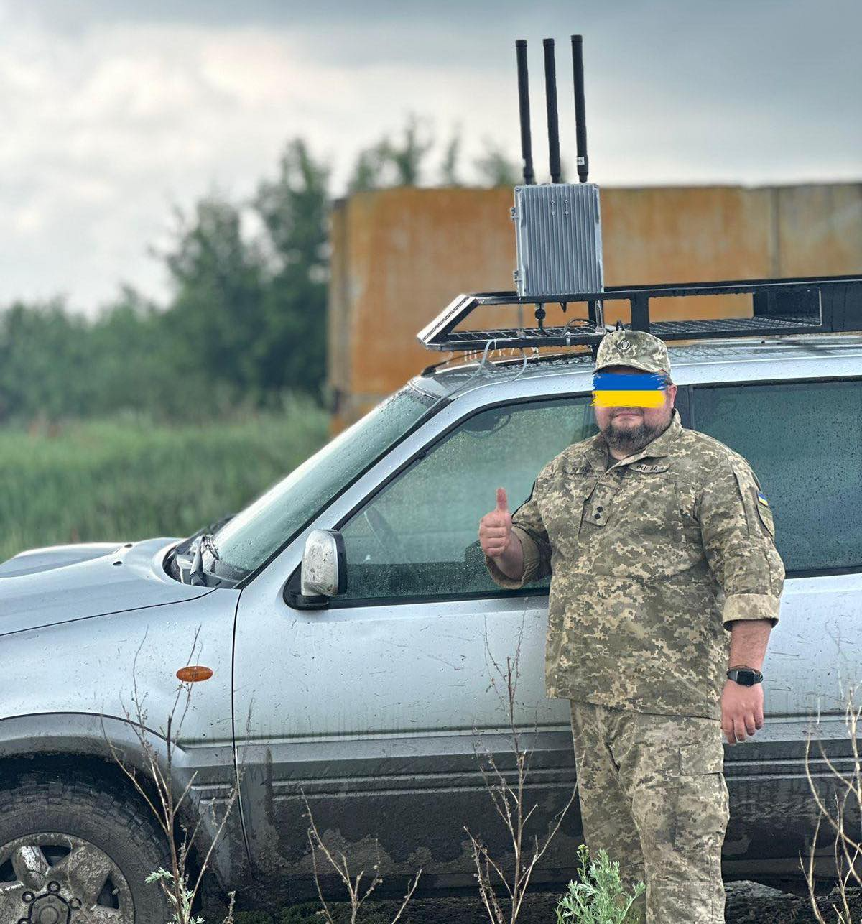
Many of the ‘Ukrainian’ EW systems are rebranded Chinese systems sold at 3-5x price
We provided a few customized Chinese jammers in 700-1000MHz and 400-700MHz range
UAV measures and EW countermeasures are changing too fast - need more flexible solutions
www.sunflowerseedsukraine.org

Slide 4
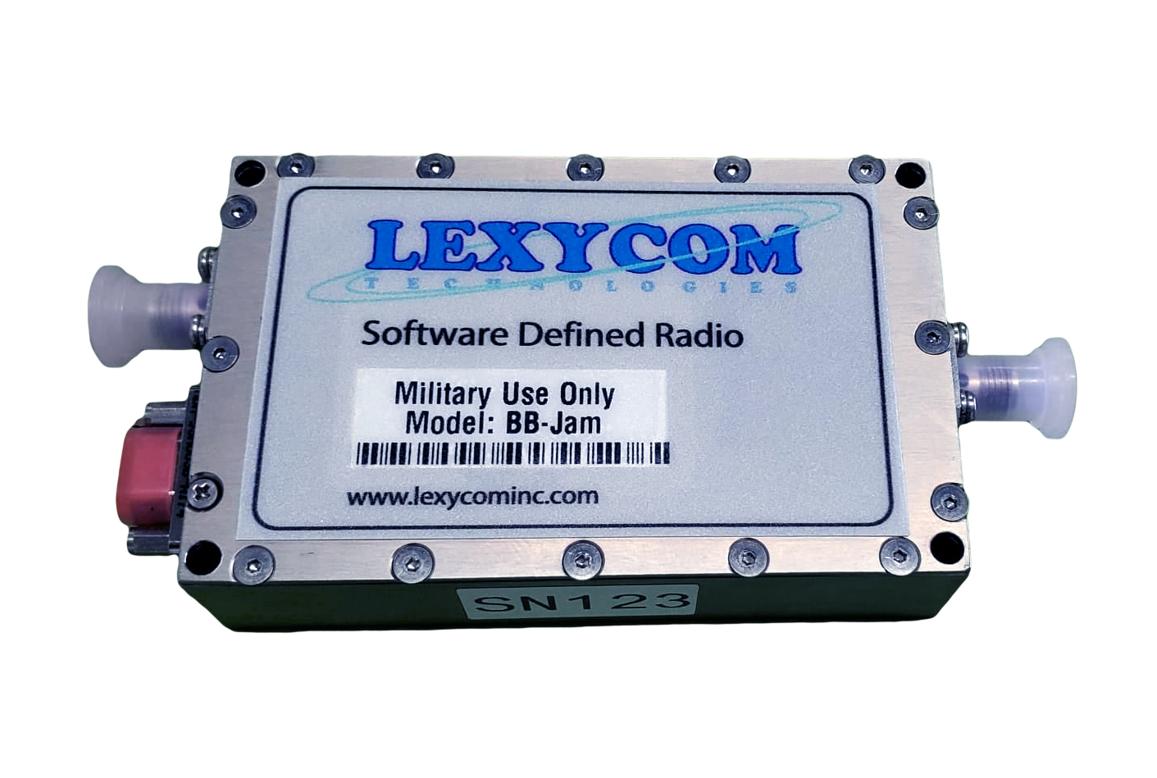
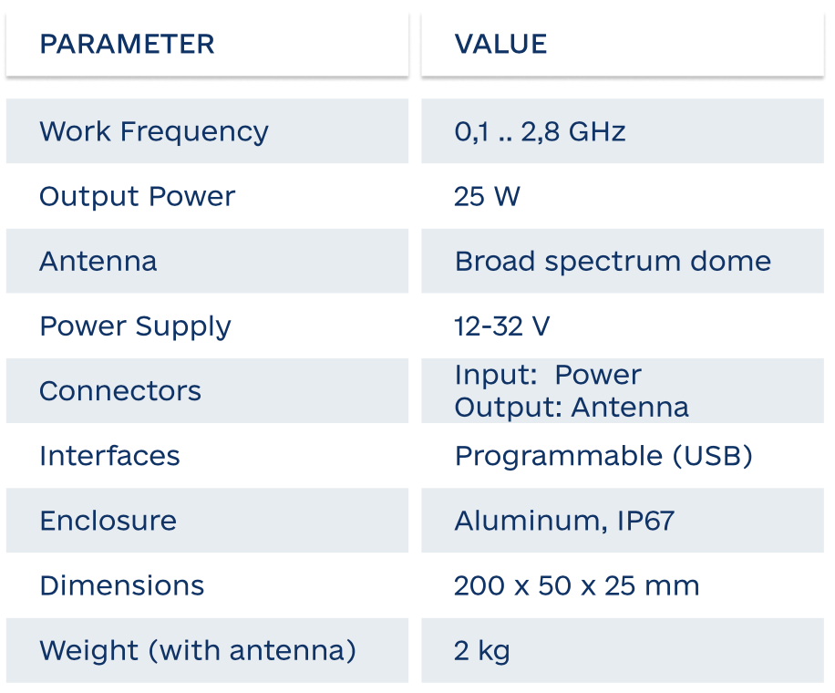


Broad Band Jammer (BBJam)
Overview
BBJam is an EWF device to interfere with control and video channels of UAV
Can be scanned continuously or work in frequency jumping modes.
Smart device with user programmable software interface
Possibility of changing device configurations in field conditions.
Current needs:
Robust broadband antenna 100MHz – 2.8GHz
Inexpensive 50-100W broadband power amplifier
More information: www.bbjam.org info@bbjam.org

Slide 5
BBJam targeted use
Supported jamming waveforms
Tactical level
Installation types
Spot jamming: multiple spots with gaps in between
Linear scan jamming: adjustable direction, speed, slope/density
WGN jamming: sectional
Company/platoon installations
Individual usage for certain tasks
Carry-on/backpack
Stationary
Vehicles
Aircraft
Increased output power (40-50W+)
Single-channel DDS-based carrier generation
Simultaneous multi-carrier in different freq. bands
Analyze the spectrum for activation
Spoofing capabilities
More information: www.bbjam.org info@bbjam.org

Slide 6






Introductions and current needs
Design and integration in the USA: Lexycom technologies, Inc (Alex, Slava, Denis)
Export from USA and import to Ukraine: Sunflower Seeds Ukraine (Andriy)
Representation and support in Ukraine: Ukrcertico LLC (Mykola)
Alex
Slava
Denis
Mykola
Andriy
Current needs:
Integration in Ukraine – currently Lexycom in the USA
Testing and certification – currently Brave1 and individual units
Fundraising/funding – currently Lexycom + Sunflower Seeds
Import into Ukraine – need end user certificates co-signed by MOD
Technical support in Ukraine – currently Ukrcertico

Slide 7
Lexycom technologies, Inc
More information, capabilities, and other products

Slide 8

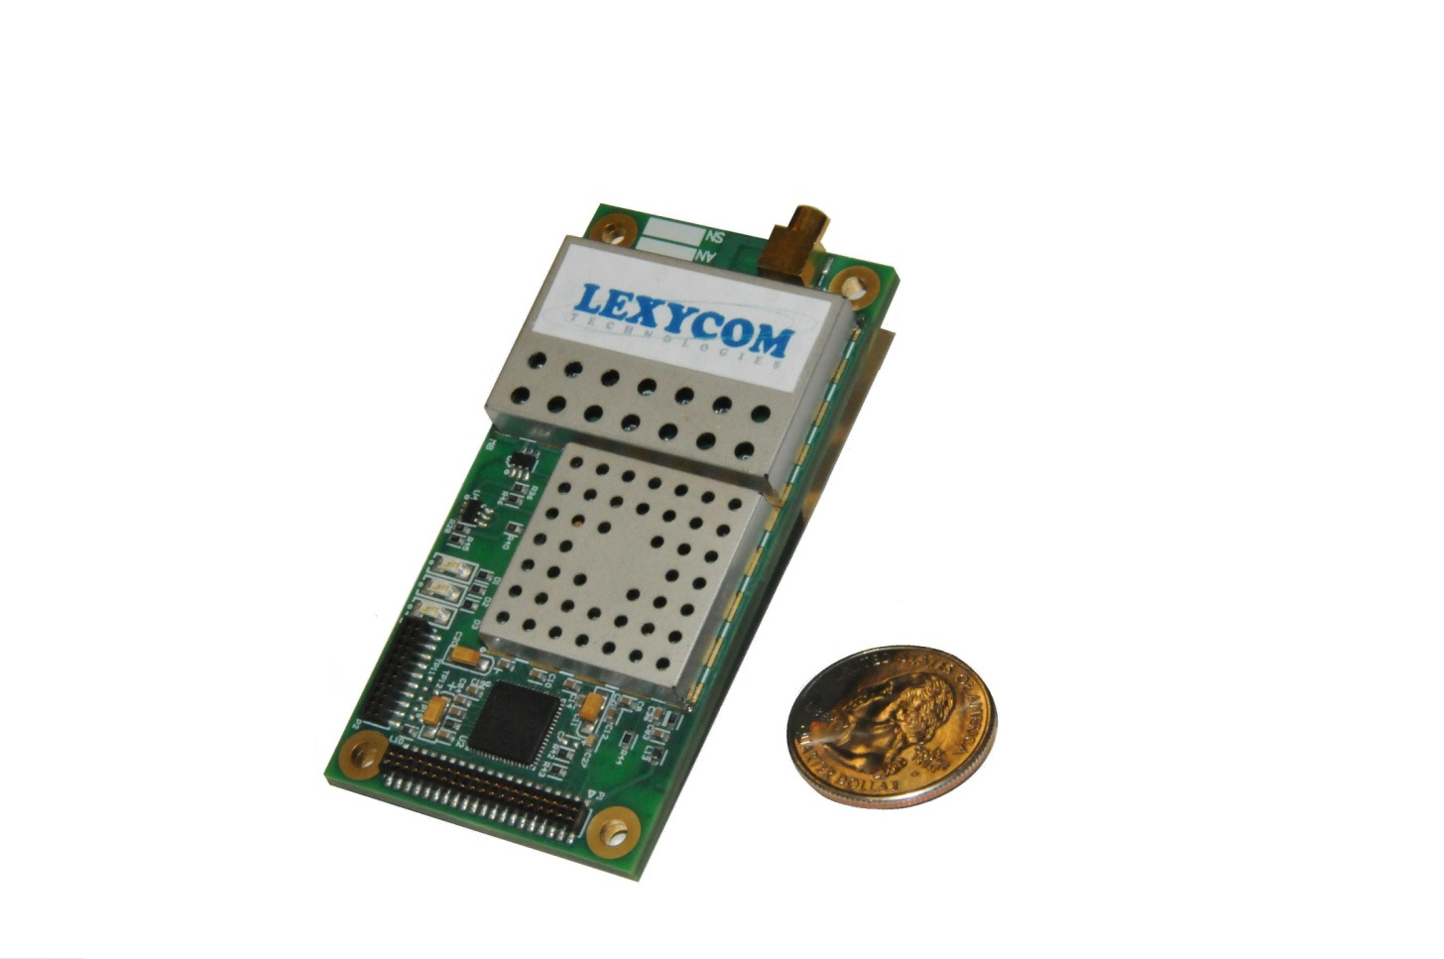


Multi-Band
LEXYCOM’s Lineup
of DoD Products
Flexible
SDR
technology
Scalable
Lightweight
Modular
TDMA, P2P/P2M, AdHoc, Mesh, Cognitive TDMA (QoS-based waveform variation)
SMART ANTENNA INTERFACE
(Self-Structuring Beam Steering)
RECONFIGURABLE (Data rates 1.2kbps-8Mbps)
MULTIPLE DATA TYPES (Simultaneous)
SECURITY (FIPS-certified Encryption)
www.lexycominc.com
8

Slide 9



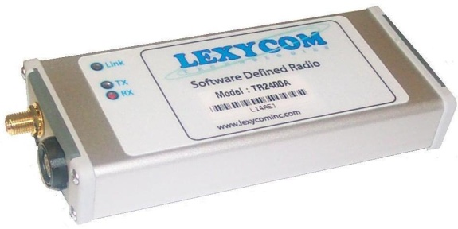
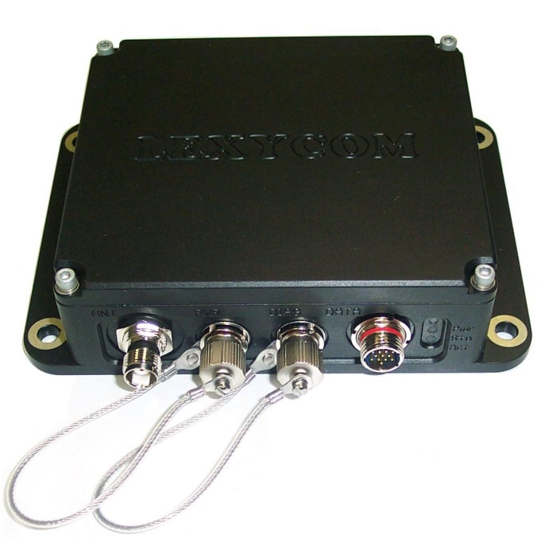
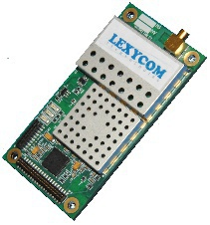
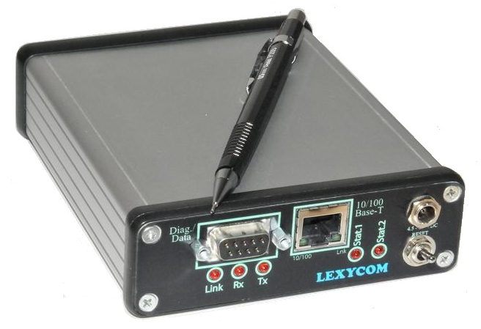
SDR Family Specific Specs.
Current Product Families
Options available on all SDR Families
Network
UHF
VHF
L-band
S-band
Terra Family
Tiamis Family
ARDS Family
EVA Family
156-176MHz, 410-480 MHz
Up to 50W
1.2kbps..36kbps
860-928MHz
Up to 3W
115.2kbps..1.2Mbps
1.3GHz
Up to 5W
230kbps..2Mbps
2.3..2.4GHz
Up to 5W
19kbps..8Mbps
Telmair Family
Multi-band SDR
270-400MHz
Up to 10W
57kbps..1.2Mbps
May include up to three RF sections each of which covers 860-928MHz, 1.3GHz, or 2.3..2.4GHz frequency bands
Security
Interfaces
Board-level/Enclosure (3oz .. 5lbs)
FIPS-certified AES crypto
User-defined freq. hopping
P2P
P2M
Mesh
MANET
Waveform
Ethernet: bridge, UDP, TCP/IP
Programmable IOs
SDLC
Up to 4 UARTs
(sync or async)
External highpower PA cntrl
Packet-by-packet waveform alternation
Multi-data via one SDR: 5 streams (video, C2,TSPI, etc.)
Multiple modulation types
Mltpl FEC schemas
www.lexycominc.com
9

Slide 10

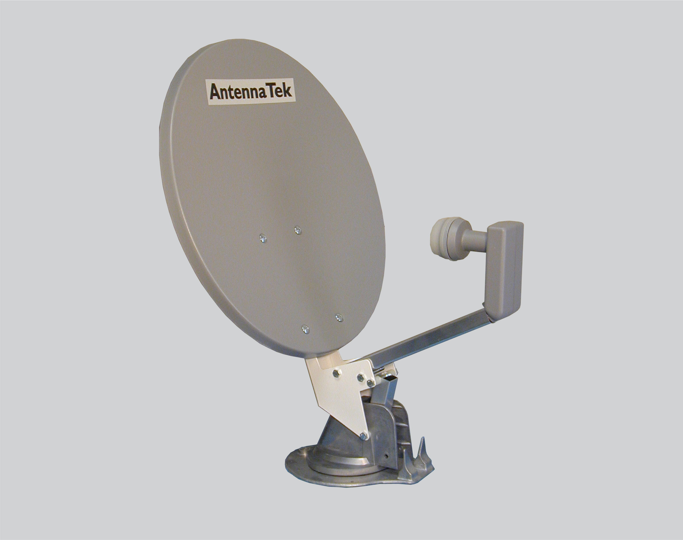
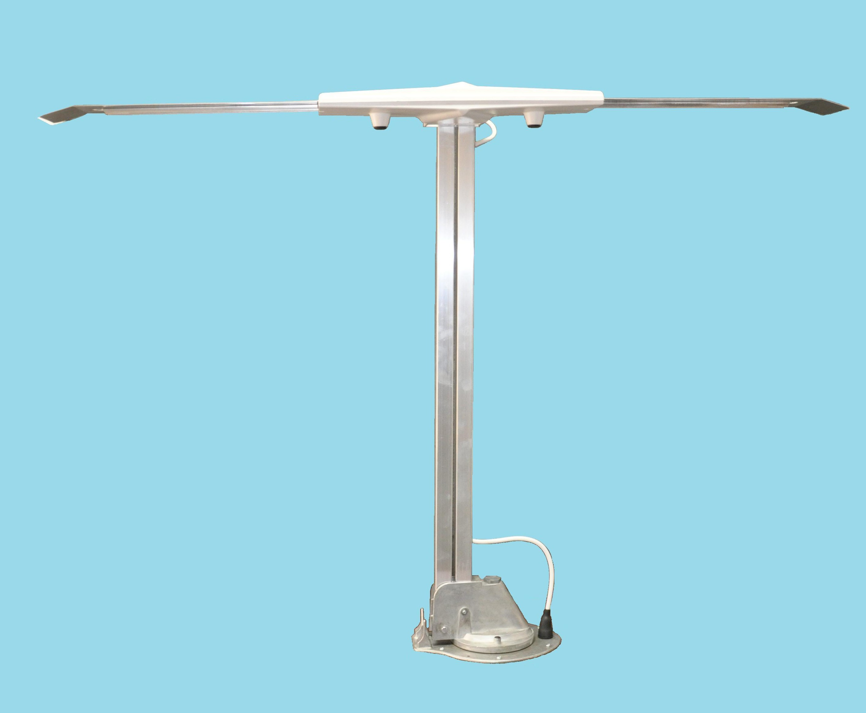
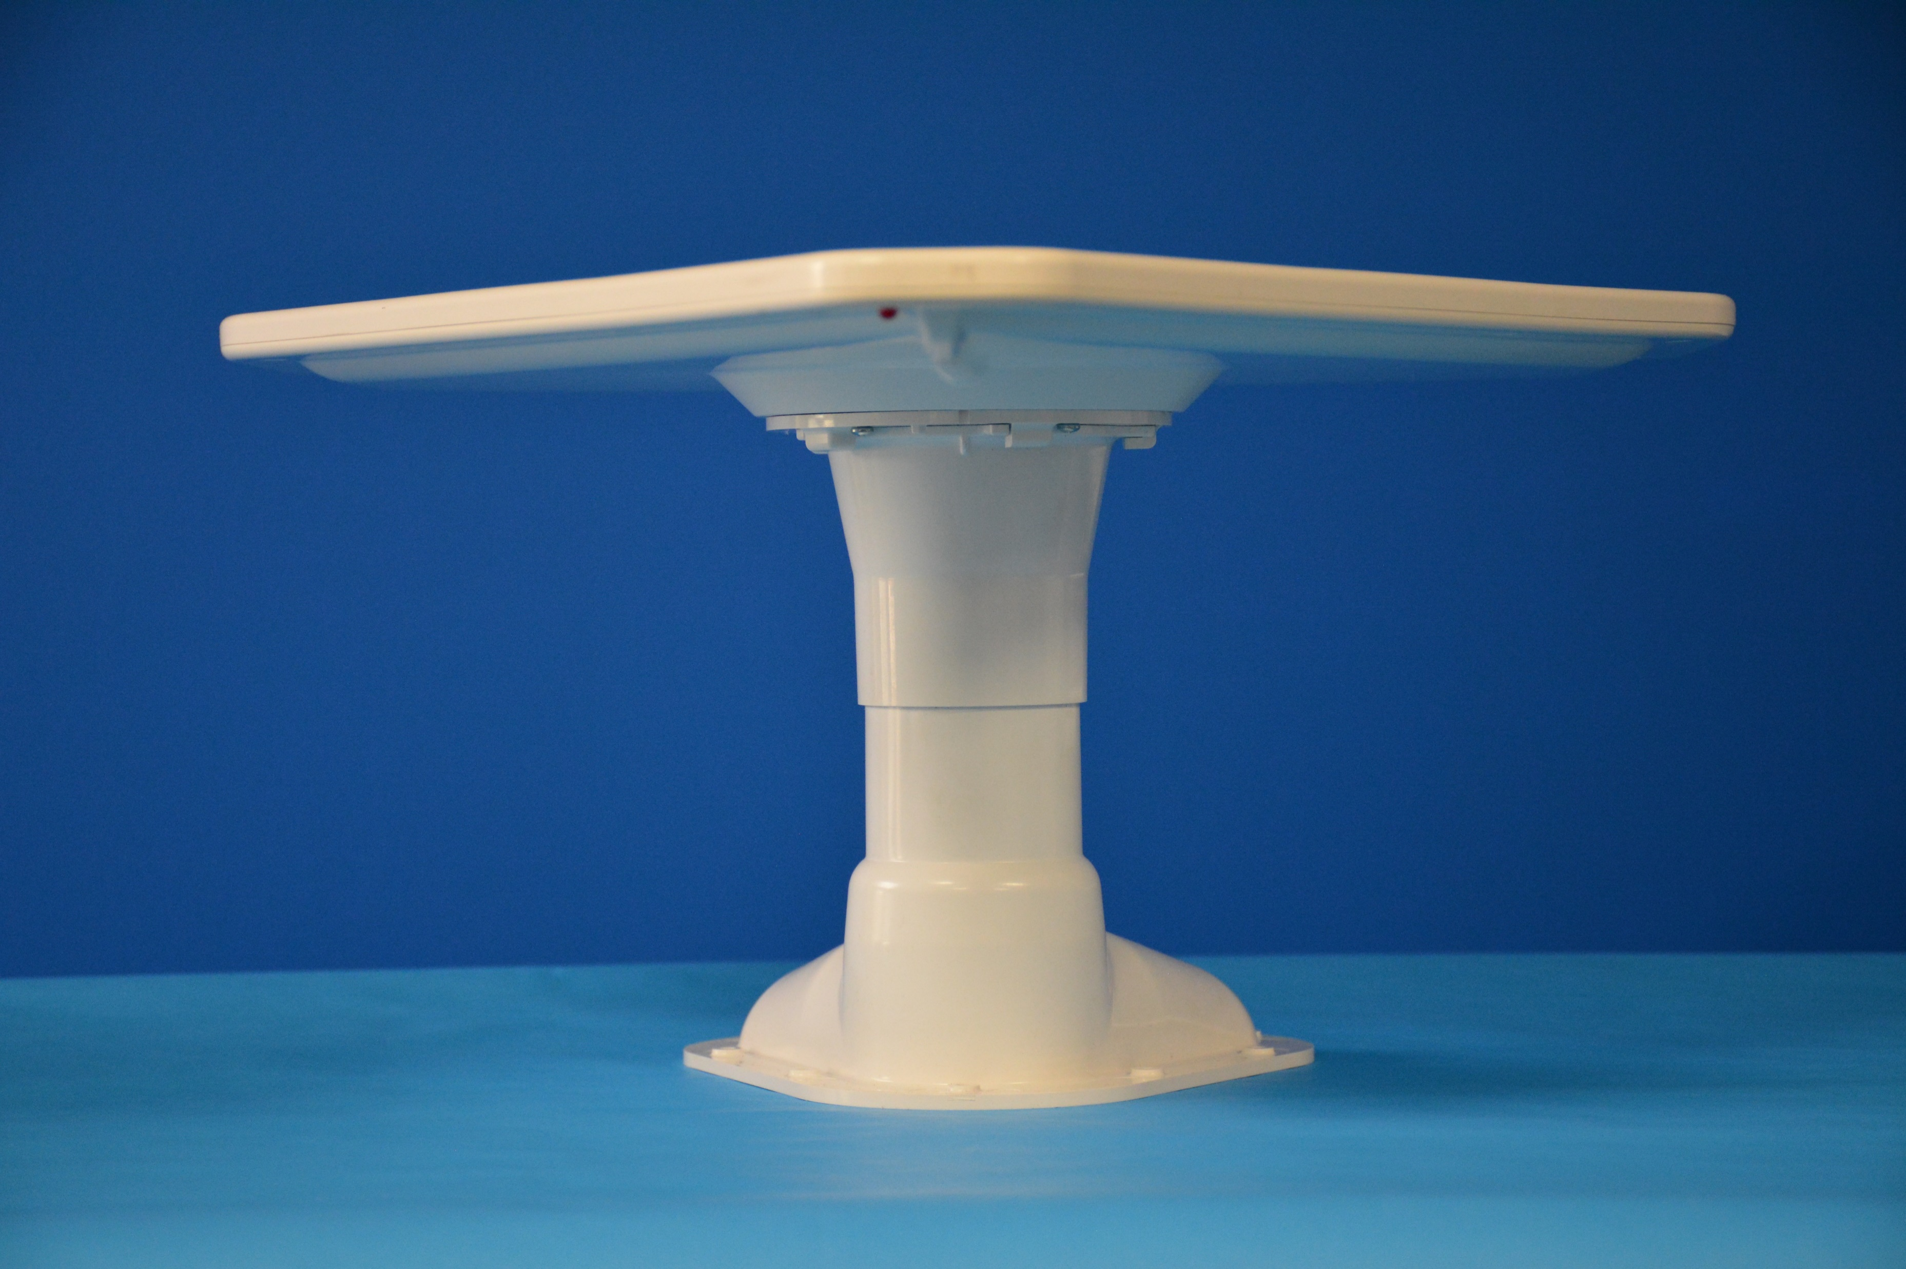
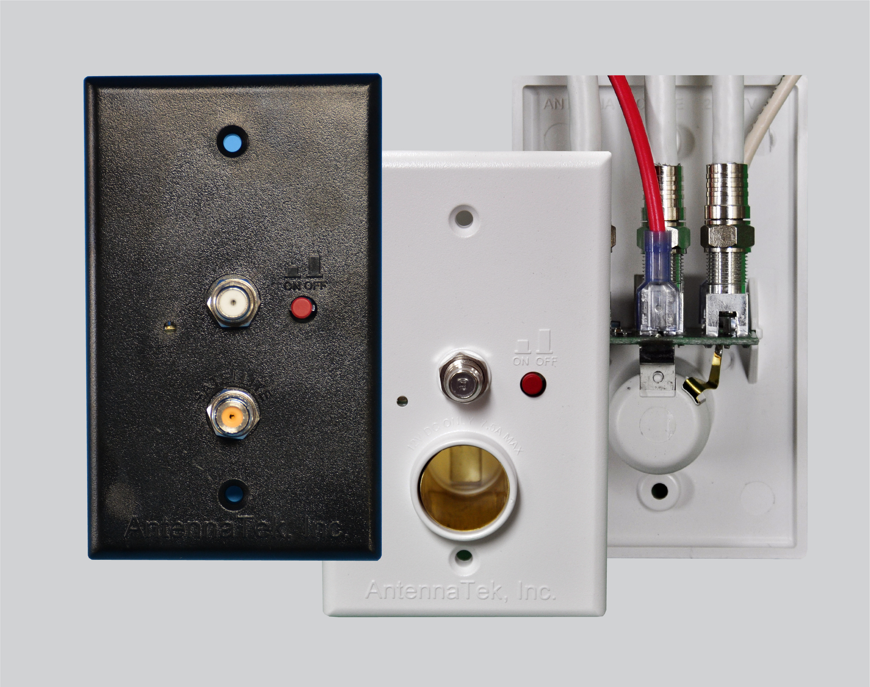
Outline of the Antenna Products
Prototyping and Full-Rate Production of Antennas
Antennas
Power supplies
Accessories
‘LPDA’ Family
‘Signal Commander’ Family
Satellite antennas
single TV/FM outlet
two TV/FM outlets
three TV/FM outlets
Miscellaneous items supporting the Antennas and the Power Supplies
Spare Parts
10

Slide 11
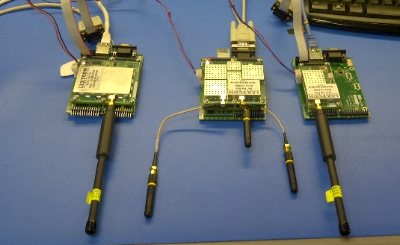
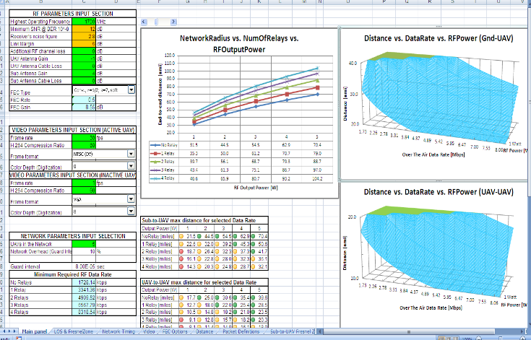
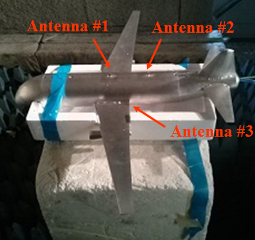
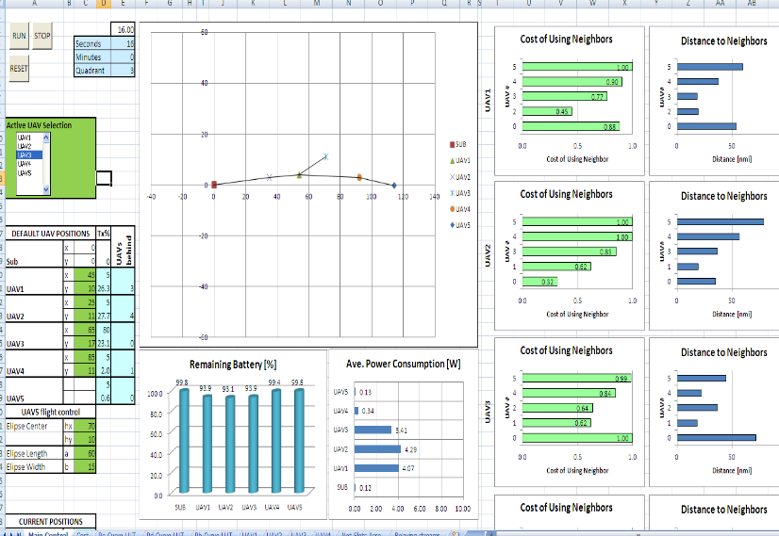
Prototyping, Production Capabilities, R&D Tools
Production Capabilities
Unique R&D Tools related to Air-Force applications
Owns surface-mount and
through-hole production assembly
lines
Jamming/EMI simulation setup
The factory includes a set of metal
processing, packaging, and
warehouse management machines
Screenshot of Lexycom’s MANET Analysis tool.
R&D lab equipped to perform the
majority of MIL-STD-461 EMI &
environmental testing
Scaled model of an aircraft with three blade antennas being measured in the anechoic chamber
Screenshot of Lexycom’s AdHoc Network real-time simulator.

Slide 12
Currently Utilized SDR’s Modular Architecture
Main Processor
FPGA
FPGA Module
RF Front End
Various Data Ports
FPGA Interface
Processor Interface
Rx Chain
MFE
Rx RF
Cordic
Costas
Antenna Module
RxADC
Decoder
Data Ciphering
Tx Chain
Seq
Tx RF
TxDAC
Network Support
FEC
Int
Mod
C2 Interface
Dynamic Clocking
Optimized Power Efficiency
Software driven rather than h/w-based
Built using COTS
parts, mostly
discreet components
12

Slide 13
Lexycom’s war-games/training network example
(fielded (TRL9); up to 1000 players; Video/Voice/TSPI/C2 on-the-fly config. per player)
Repeaters (Rpt) support multiple sub-networks
The Repeaters (Rpt) provide adequate RF coverage
Rpt
Rpt
The Rpts can be daisy-chained or branched off
Team1
Rpt
Rpt
Some players can be assigned higher downlink rates, on-the-fly adjustments
Reception of the downlinks from players by more than one GS is allowed
Team2
Players can be grouped into sub-networks. Several sub-networks may operate in the same geographical area.
Roaming players are supported
Players that are outside of the Rpt coverage use neighbors to relay their data
Master
The Rpts are wirelessly linked to each other when land-lines are not available
Rpt
When available, land-lines are used to connect to Rpts
Ethernet
Rpt
Video links are shared among team members. The video data is gathered at the Master

Slide 14
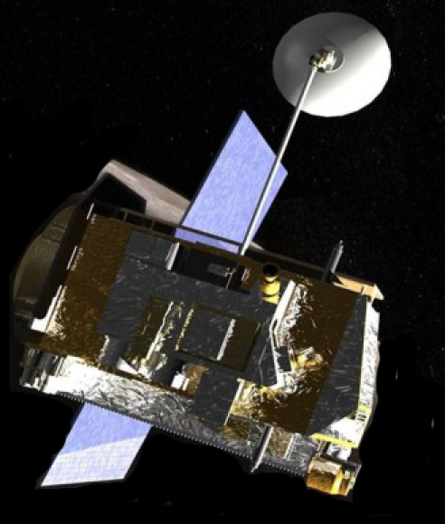



Planetary Exploration, SDR nodes, Cancellation Program (unclassified)
Depicts placement of Lexycom’s SDRs

